Slide 1


Course Name: Open Source Programming Faculty Name: JayaKumar Sadhasivam Project Topic: Online Streaming Service
1 /
Notes:
1

Slide 2

OPEN-SOURCE-PROGRAMMING(J-COMPONENT):
Group Members:
19BIT0323 : Aadi Manchekar (Front-end, DBMS dev) 19BIT0319 : Roshan Mishra (Front-end, Back-end dev) 19BIT0309 : Mrigank Batra (Back-end dev)
2 /
Notes:
2

Slide 3

Review I

Slide 4
Topic: Online Streaming Service
Our aim is to create a streaming service that offers a wide variety of award-winning TV shows, movies, anime, documentaries, and more on thousands of internet-connected devices. You can Watch on your smartphone, tablet,laptop.
A media stream can be streamed either "live" or "on demand". Live streams are generally provided by a means called "true streaming". True streaming sends the information straight to the computer or device without saving the file to a hard disk. On-demand streaming is provided by a means called progressive streaming or progressive download.
The quality of the interaction between servers and users is based on the workload of the streaming service; as more users attempt to access a service, the more quality is affected unless there is enough bandwidth or the host is using enough proxy networks.
4 /
Notes:
4

Slide 5

Technologies used
5 /
Notes:
5

Slide 6


Technologies used(contd.)
6 /
Notes:
6

Slide 7
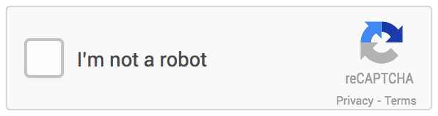


Slide 8
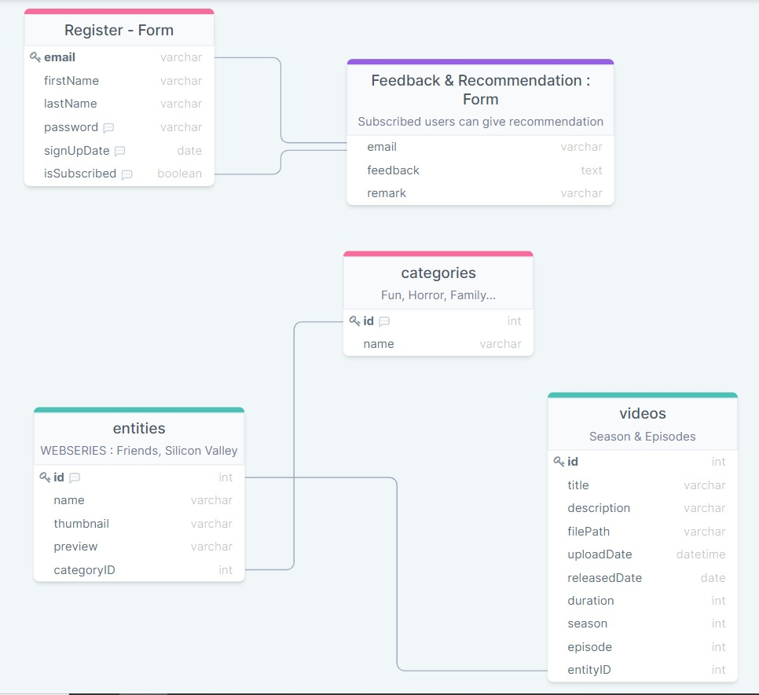
Relationship Diagram:
8 /
Notes:
8

Slide 9
Creating the online movie experience:
Most people don’t know it, but streaming services only uses its own IP address and hostname service.com for two key functions.
Registration of new user accounts and capture of payment information (credit card or PayPal Account
Redirection of users to movies.streaming.com or signup.com based on whether the user is logged in or not respectively.
9 /
Notes:
9

Slide 10
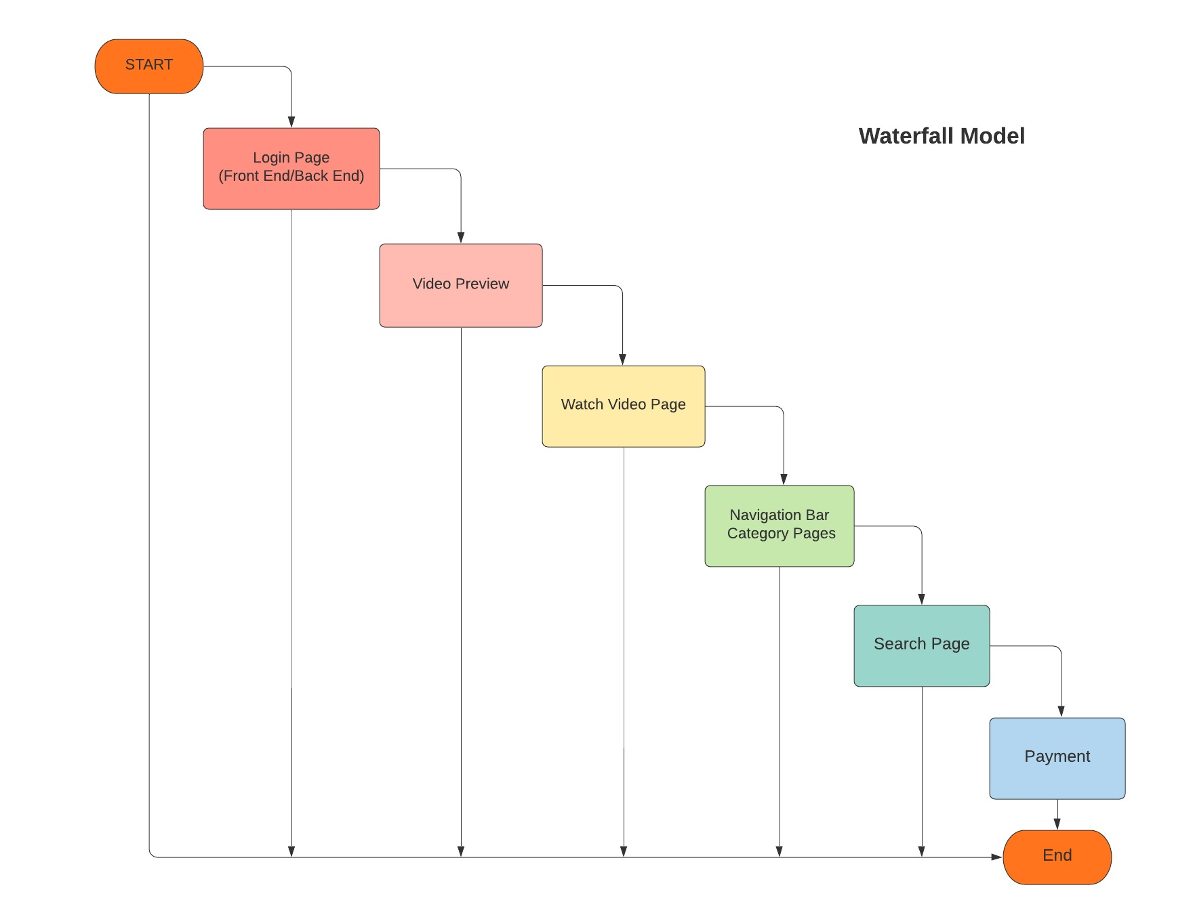
Flow-chart
10 /
Notes:
10

Slide 11
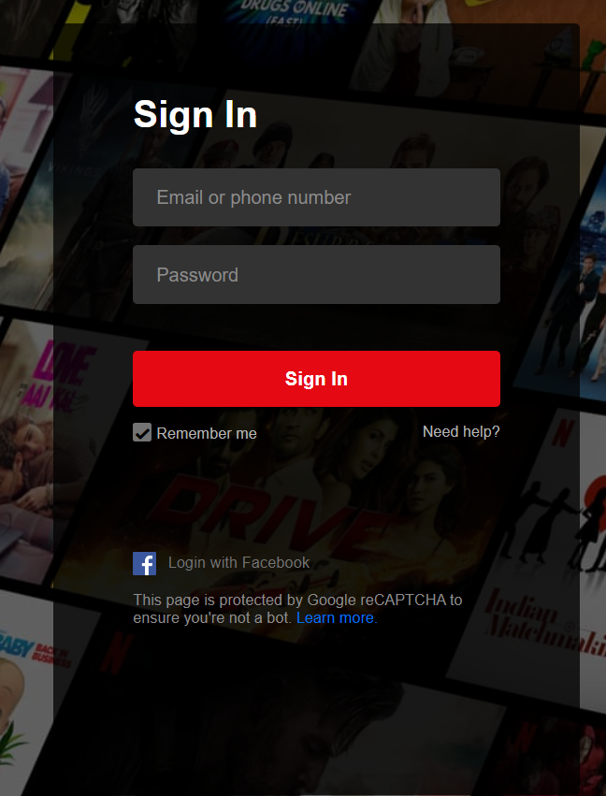
11 /
Notes:
11

Slide 12
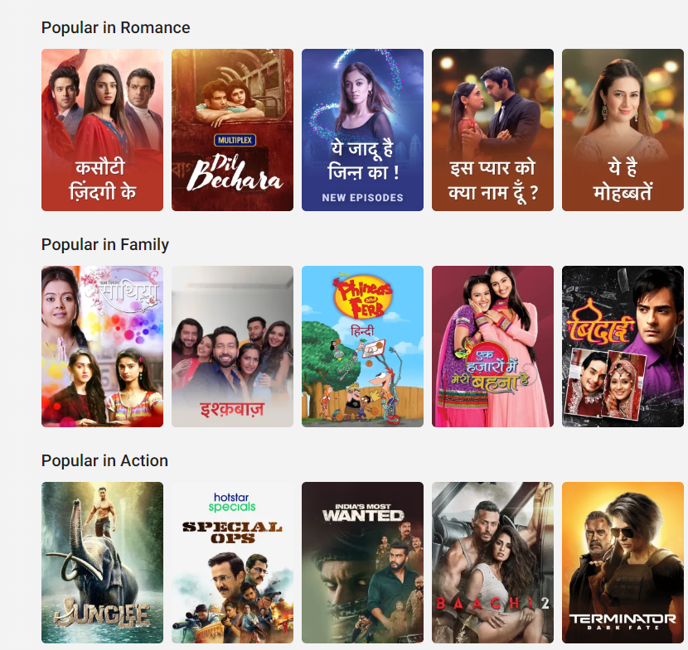
12 /
Notes:
12

Slide 13
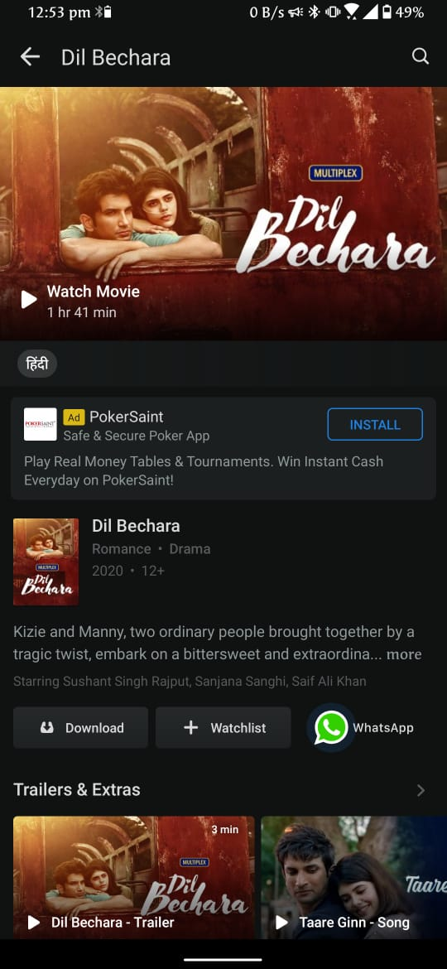
13 /
Notes:
13

Slide 14
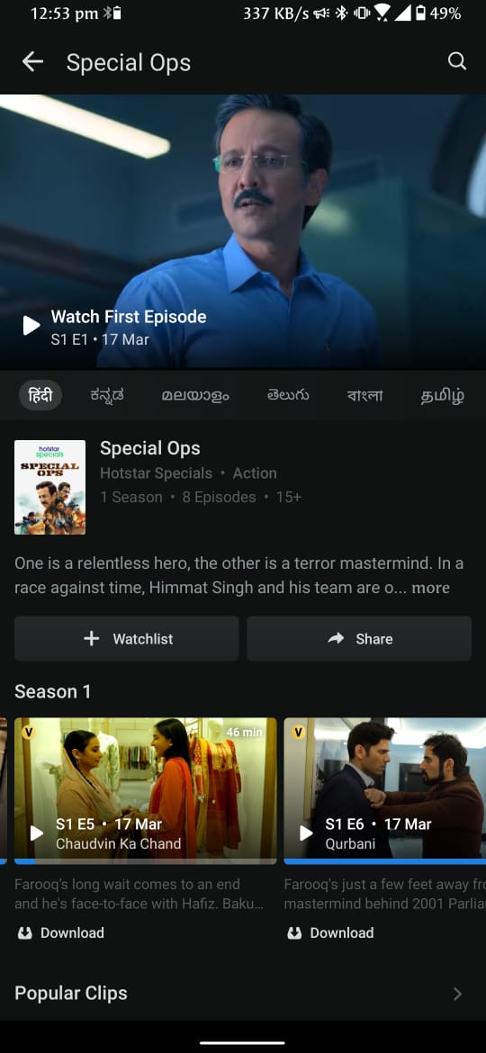
14 /
Notes:
14

Slide 15
Review II

Slide 16
Relational schema

Slide 17
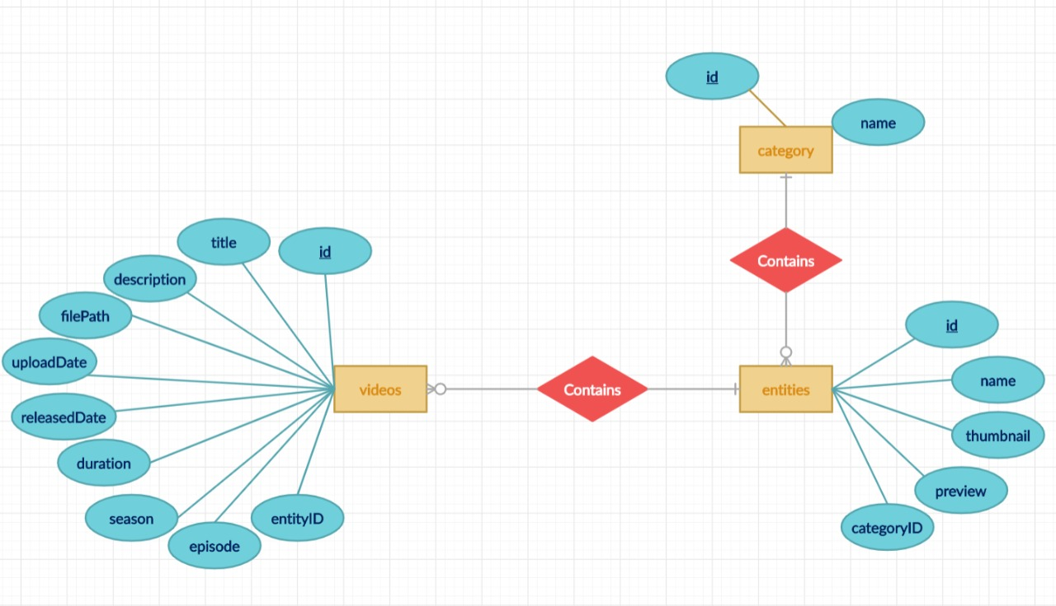
ER-DIAGRAM

Slide 18
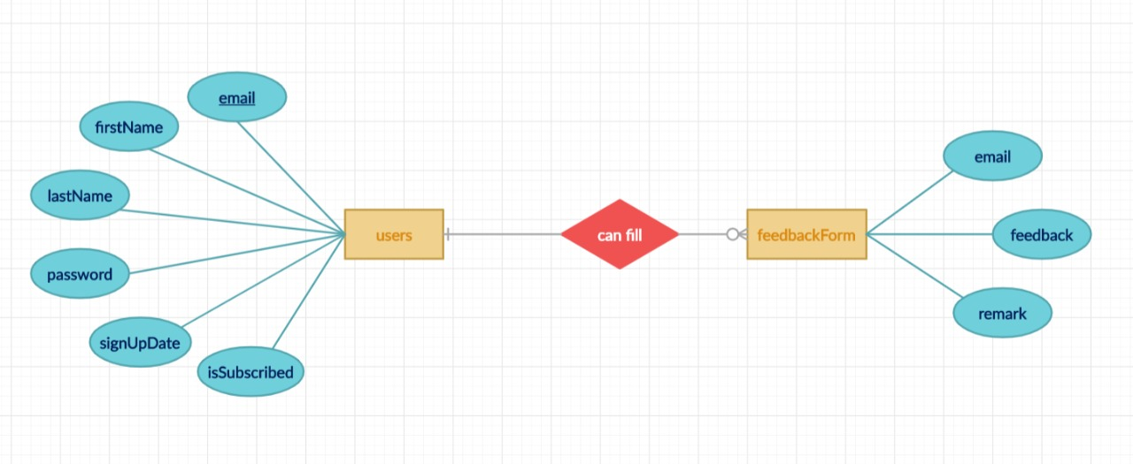
ER-DIAGRAM

Slide 19


Slide 20
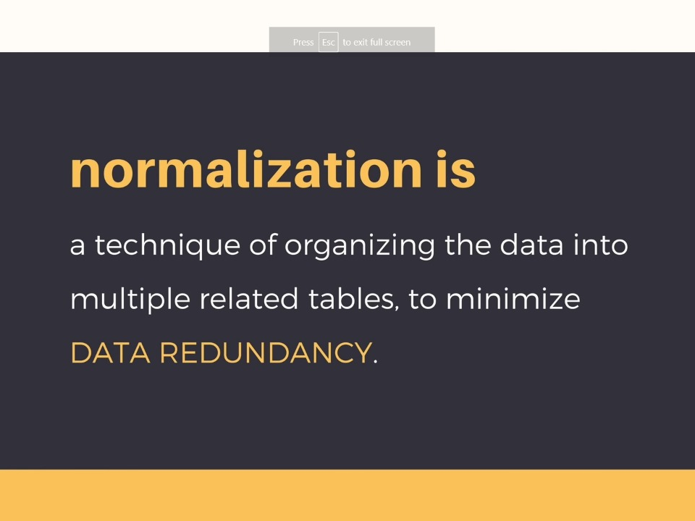

Slide 21
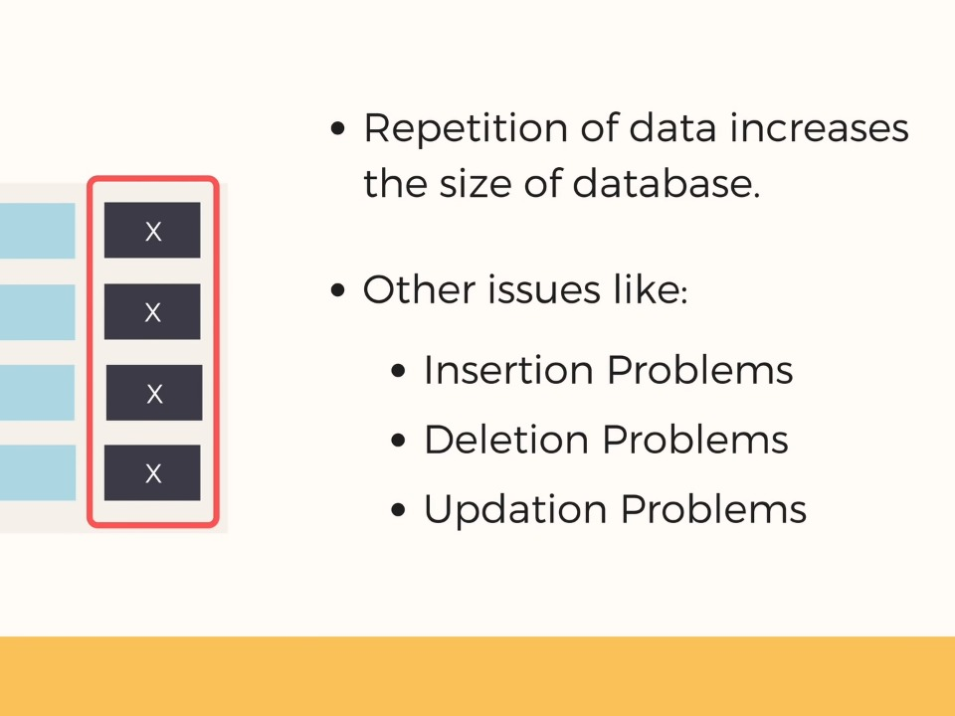

Slide 22
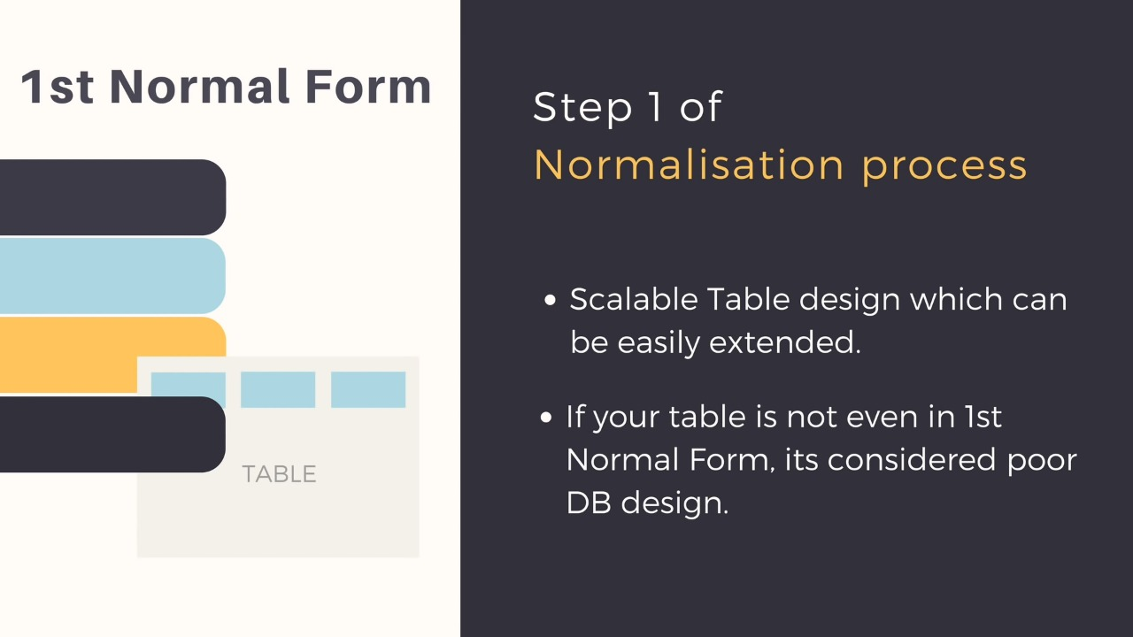

Slide 23
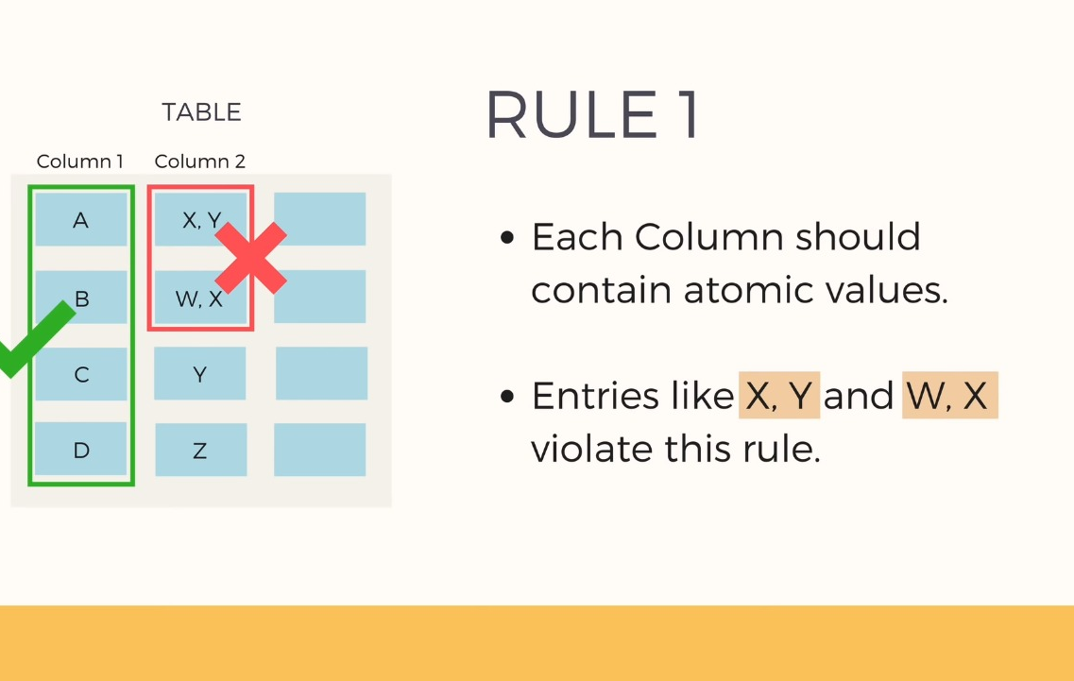

Slide 24
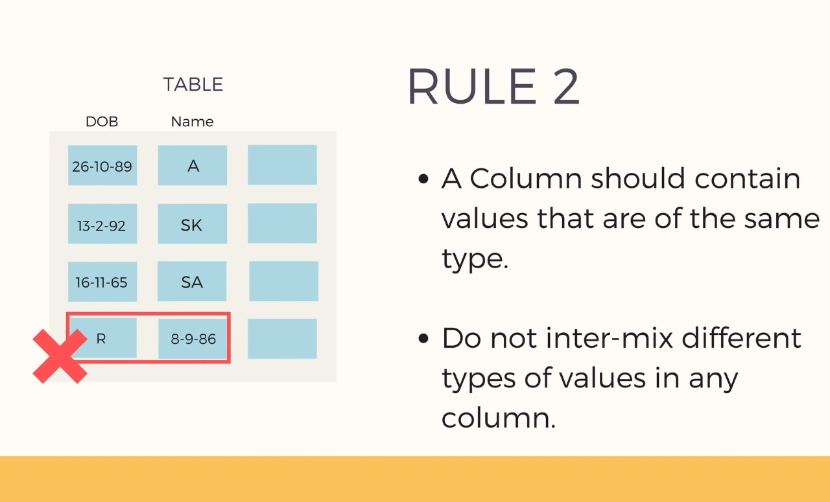

Slide 25
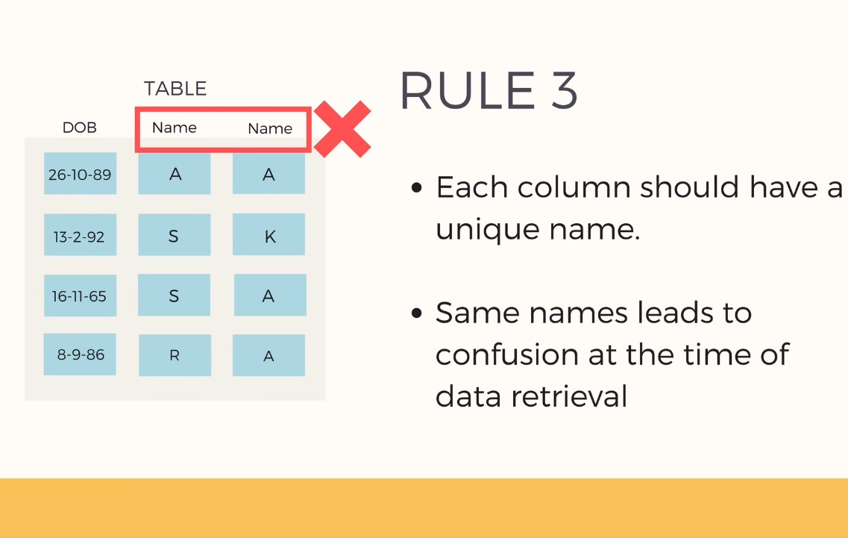

Slide 26
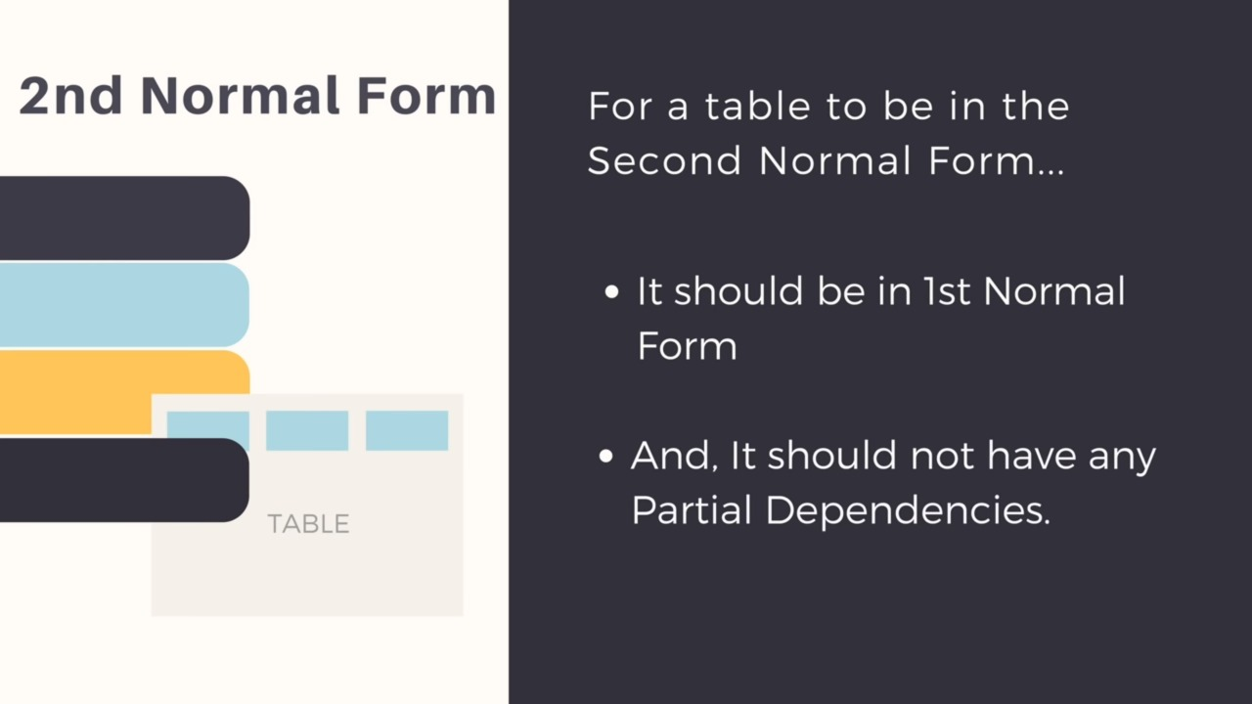

Slide 27
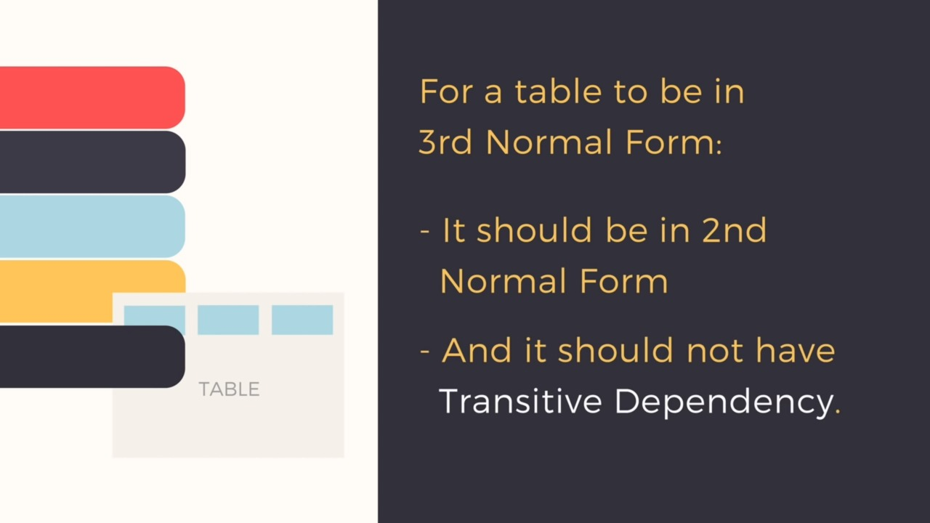

Slide 28
Snap Shots of working prototype

Slide 29
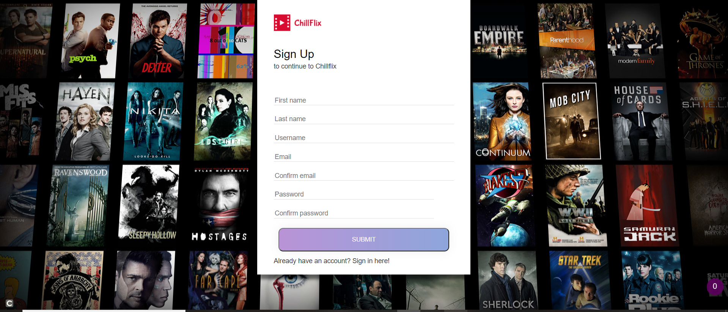
(Register.php)

Slide 30
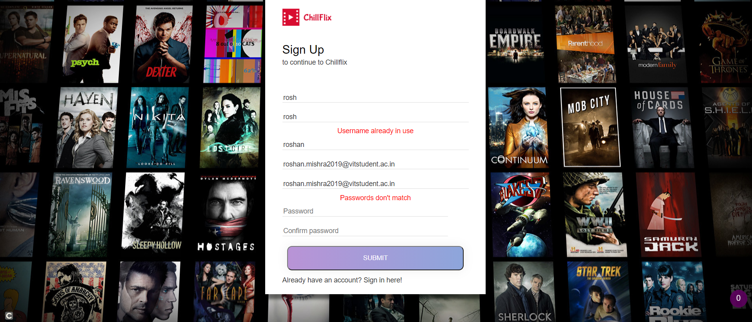
(register.php-error messages)

Slide 31
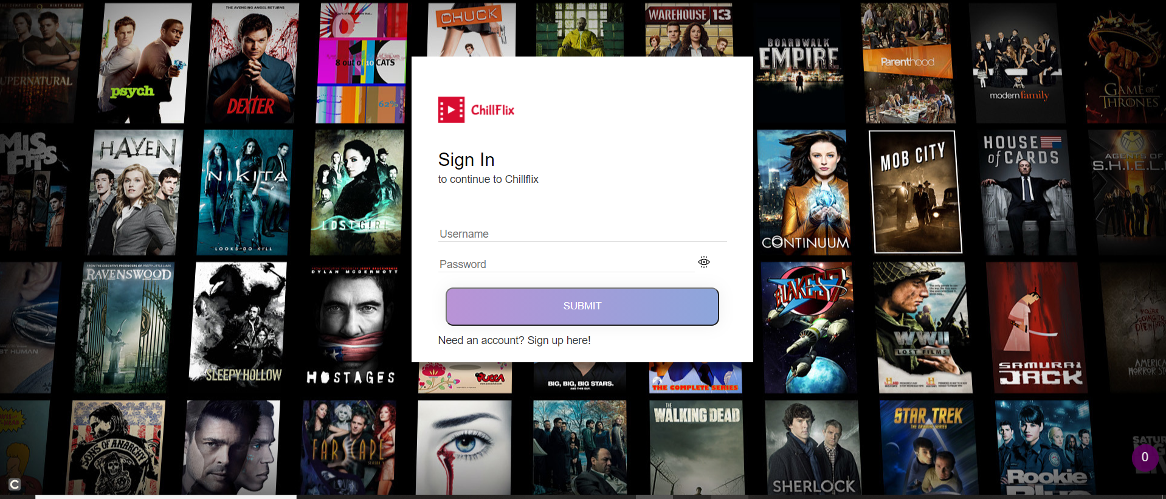
(login.php)

Slide 32
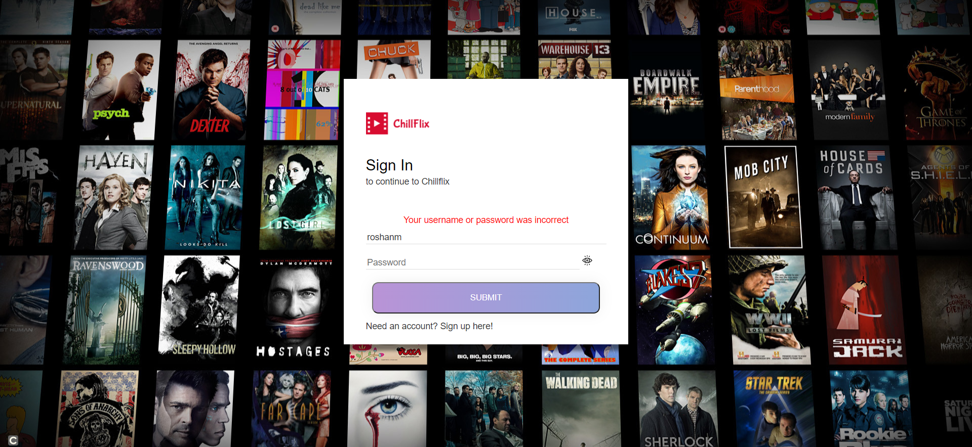
(login.php-errors)

Slide 33
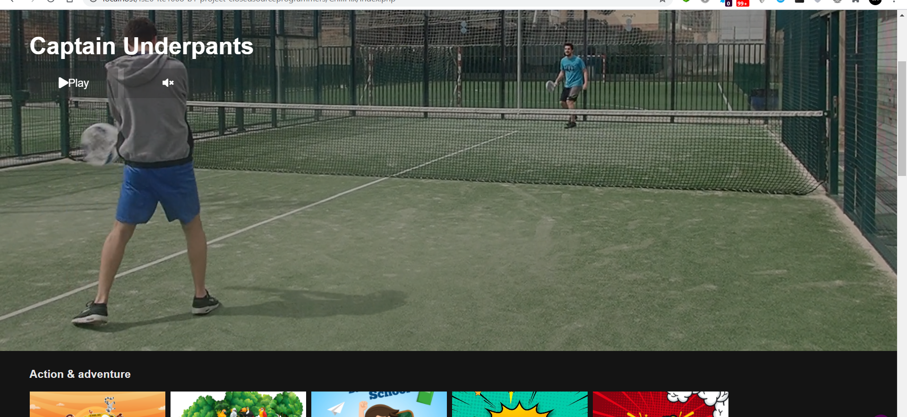
(index.php)

Slide 34
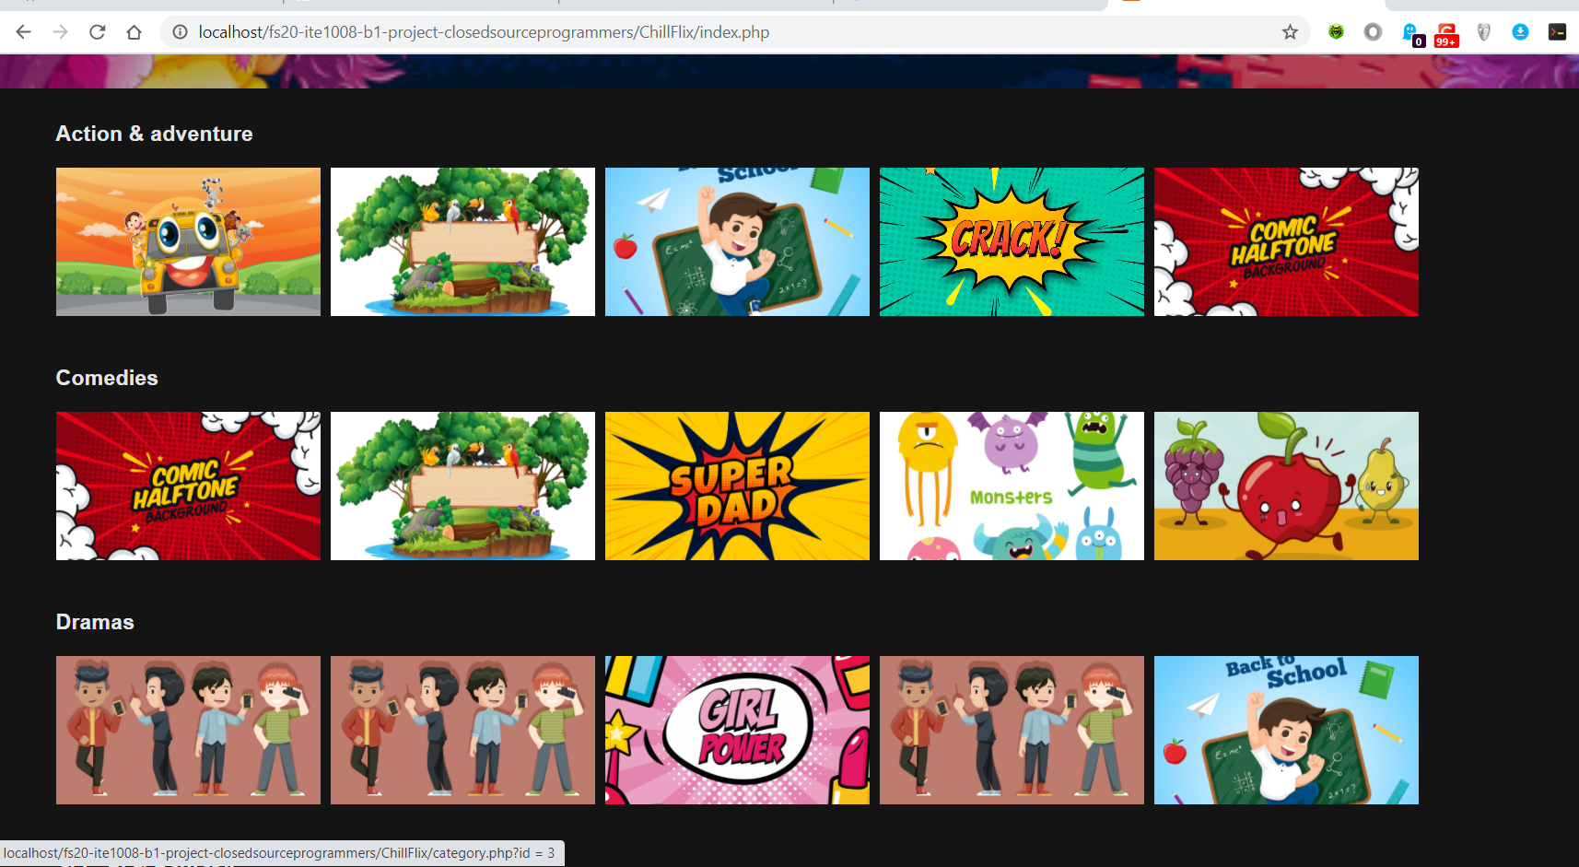
(index.php)

Slide 35
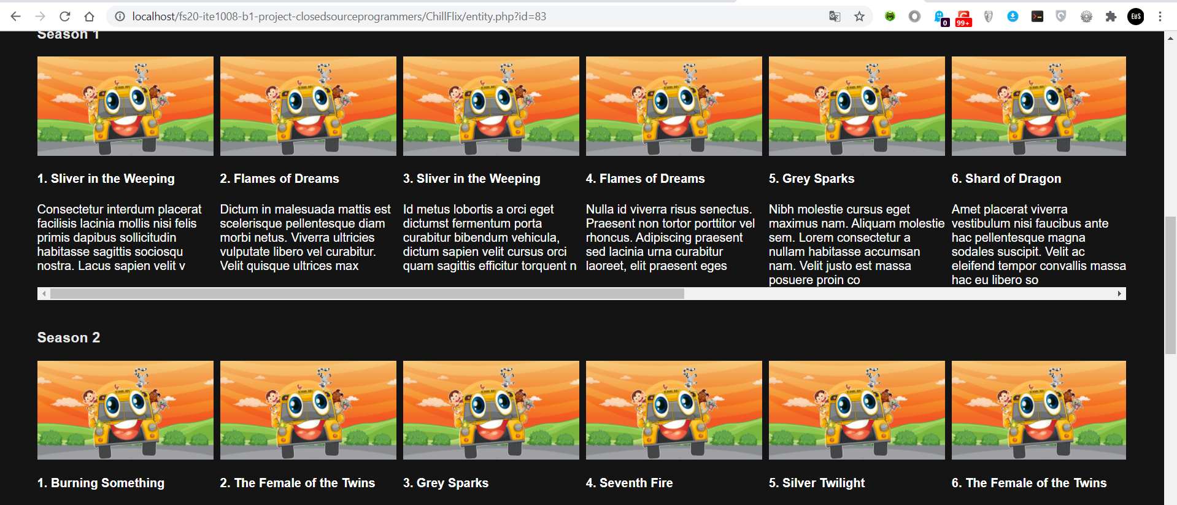
(entity.php)

Slide 36

Plans and improvements

Slide 37
Navigation Bar

Slide 38
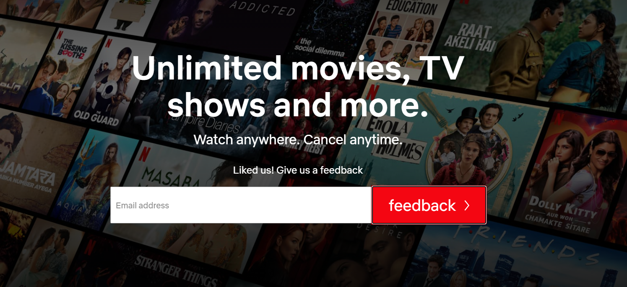
Feedback Form

Slide 39

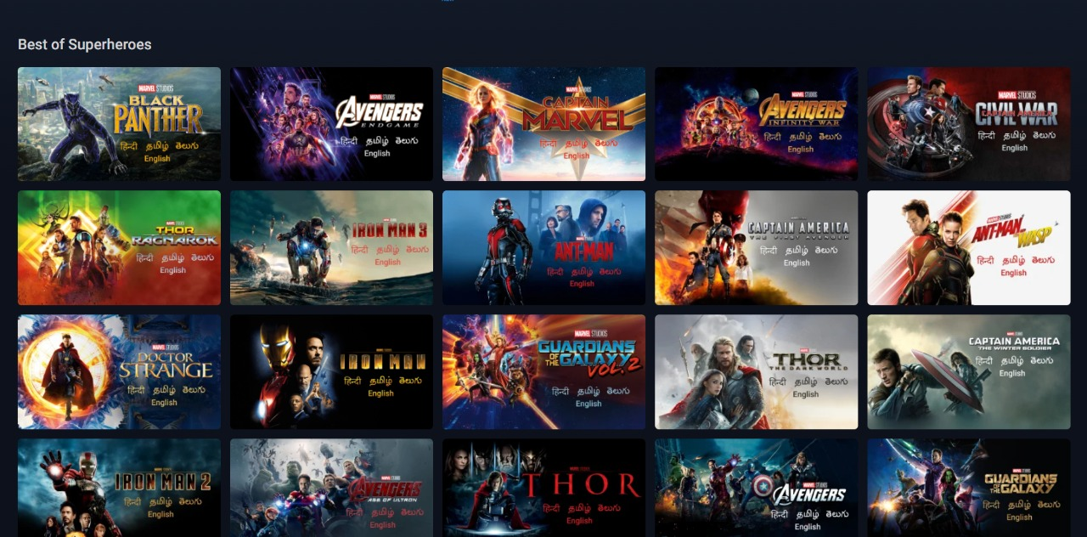
Category Page

Slide 40
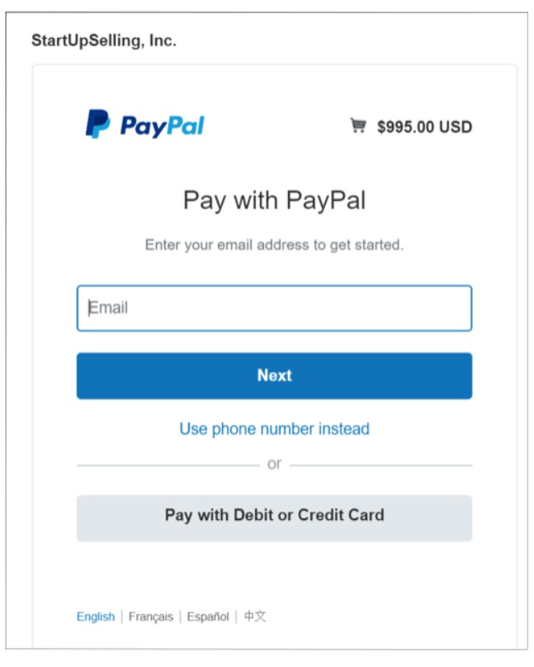
Payment Integration

Slide 41
Link to Trello board:
https://trello.com/b/cnZQTKyB/chillflix

Slide 42
Thank you.
19BIT0323
19BIT0319
19BIT0309

